Slide 1
How To Read Data From Excel Using Apache POI

Slide 2
What is Apache POI?
Apache POI, where POI stands for (Poor Obfuscation Implementation) is an API that offers a collection of Java libraries that helps us to read, write, and manipulate different Microsoft files such as excel sheets, power-point, and word files.

Slide 3
Steps TO Download Apache POI Jars
Refer the below link to find the steps
https://www.toolsqa.com/blogs/download-apache-poi/

Slide 4
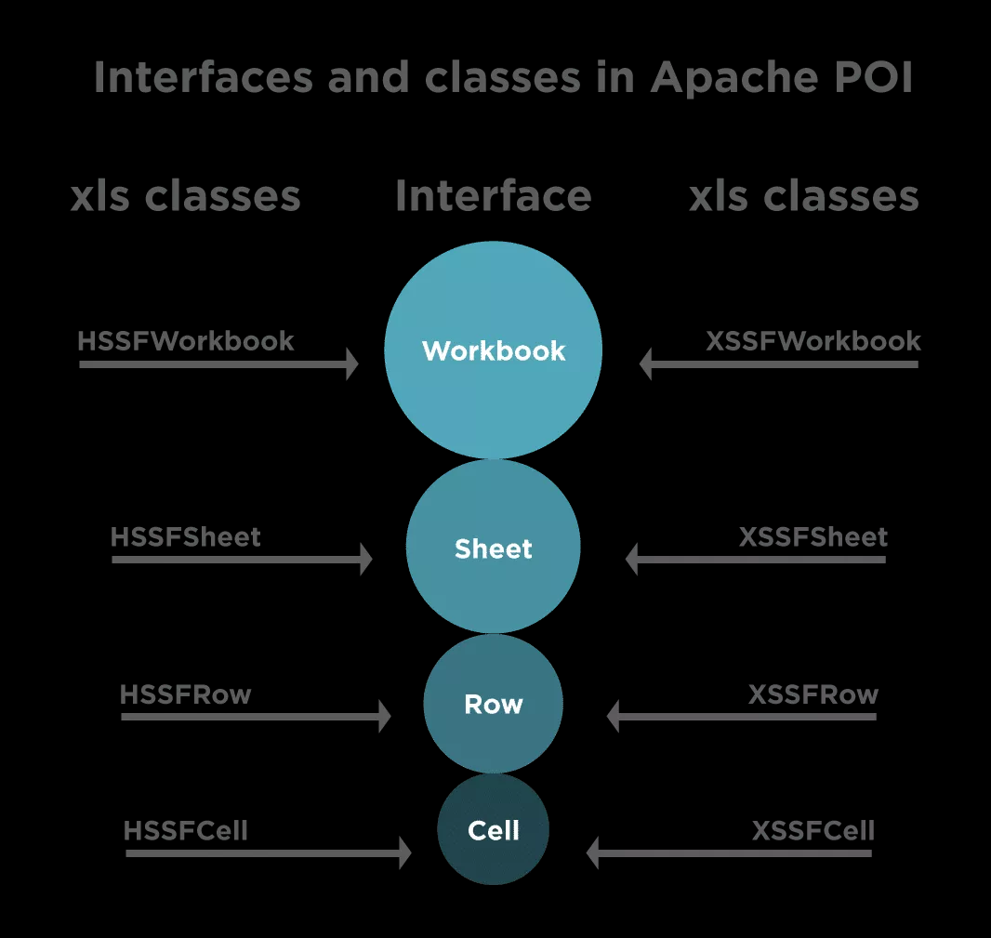
This image clearly depicts the structure and how the classes and interfaces are aligned in Apache POI.

Slide 5
How to manage Excel workbooks ?
Apache POI provides various interfaces and classes that help us to work with Excel. It provides a “Workbook ” interface to maintain Excel Workbooks. There are certain classes that implement this interface and we use these classes to create, modify, read, and write data in Excel files. The two mainly used classes for managing Excel Workbooks are:
HSSFWorkbook- These class methods are used to read/write data to Microsoft Excel file in .xls format. It is compatible with MS-Office versions 97–2003.
XSSFWorkbook- These class methods are used to read-write data to Microsoft Excel in .xls or .xlsx format. It is compatible with MS-Office versions 2007 or later.

Slide 6
How to manage Excel Sheets ?
There is another interface, “Sheet “, which we use to create a sheet in the Workbook. There are two classes that used to work with sheets, same as we have for Workbook Interface
HSSFSheet – This class is used to create a new sheet in the HSSFWorkbook, ie, the older format of Excel.
XSSFSheet – This class is used to create a new sheet in the XSSFWorkbook., ie, the new format of Excel

Slide 7
How to manage Excel Rows ?
The Row interface provides us with the ability to work with rows in the Excel sheet. Below two classes implement this interface:
HSSFRow – This represents a row in the HSSFSheet.
XSSFRow – This represents a row in the XSSFSheet.

Slide 8
How to manage Excel Cells ?
The Cell interface helps us in accessing the cells of a particular row. There are two classes that implement this interface and we can use for reading/writing data into the cell:
HSSFCell – We use it to work with cells of HSSFRow.
XSSFCell – We use it to work with cells of XSSFRow.

Slide 9
While reading the Excel file, Apache POI can read data in two ways
- You want to read the value of a particular cell, for instance, you want to get the address of the student present in the second row.
- You can read the entire excel in one go. It is based upon the need for your test script and the data needed for test execution.

Slide 10
Some Common Steps To Follow
The first step is to obtain the Excel Workbook based upon its location on the computer
Once we create the Workbook, the next step is to create a Sheet in the Workbook either using getSheet (String sheetName) method or using getSheetAt (int index)
After the sheet creation, we have to obtain the row of the sheet, which we can retrieve using the getRow (int rowIndex) method

Slide 11
How to read a specific cell value?
Once you have got the row, you can get the cell of the row using the getCell (int index) method
After you obtain the cell that contains the data, you can read the data in different formats like String, Date, Number using the different methods which are based upon the format of the cell you specify in the excel sheet

Slide 12
How to read the entire Excel sheet?
- To read the complete data from Excel, you can iterate over each cell of the row, present in the sheet. For iterating, you need the total number of rows and cells present in the sheet. Additionally, we can obtain the number of rows from the sheet, which is basically the total number of rows that have data present in the sheet by using the calculation –
RowCount = LastRowNumber -First Row Number
To get the last and first-row number, there are two methods in the sheet class:
getLastRowNum()
getFirstRowNum()
- Once you get the row, you can iterate over the cells present in the row by using the total number of cells, that we can calculate using getLastCellNum() method

Slide 13
Reference
https://www.toolsqa.com/selenium-webdriver/excel-in-selenium/

